Slide 1

Chapter 24
People-Oriented
Methodologies
Notes:
<number>

Slide 2
Chapter 24
People oriented methodology is mainly focused on obtaining the ethical position of every individual. It emphasizes more on ethics which is a participative approach of human or people who might be the stakeholders or users. It also highlight’s that users are deeply involved in the development process and take control over the stages, it means that the users are also involved in the decision making process and fully committed to the IS development
Notes:
<number>

Slide 3
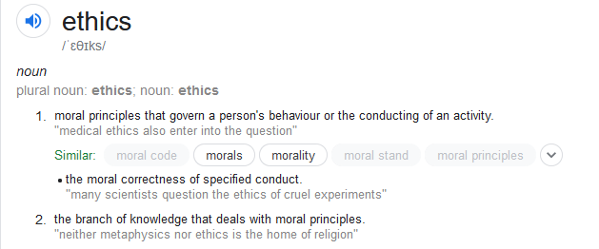
Chapter 24
noun
1. اصول اخلاق
Notes:
<number>

Slide 4
People-Oriented Methodologies
attempting to capture the expertise and knowledge of the people in the organization
methodologies include
ETHICS
KADS
CommonKADS
<number>
Notes:
<number>

Slide 5
Effective Technical and Human Implementation of Computer-based Systems (ETHICS) (Mumford 1983; 1993; 1995)
Philosophy (explicitly stated)
development of computer systems is not a technical issue but an organizational issues that is fundamentally concerned with the process of change.
Based on socio-technical approach
Mumford: … which recognizes the interaction of technology and people and produces work systems which are both technically efficient and have social characteristics which lead to high job satisfaction
Job satisfaction: the attainment of a good ‘fit’ between what employee is seeking from his work – his job needs, expectations and aspirations – and what he is required to do in his job – the organizational job requirements which mould his experience
Mold ??
<number>
Notes:
<number>

Slide 6
ETHICS
measures for job satisfaction
knowledge fit
skills/knowledge is being developed/adequately used
psychological fit
fit with status/advancement/interests
efficiency fit
effort-reward; work controls; supervisionary controls
task-structure fit
degree to which tasks are regarded demanding/fulfilling
ethical fit
social value fit
<number>
Notes:
<number>

Slide 7
ETHICS - participation
an essential part of the methodology since ISD is seen as a change process
“All change involves some conflicts of interest. To be resolved, these conflicts need to be recognized, brought out into the open, negotiated and a solution arrived at which largely meets the interests of all parties in the situation. […] successful change strategies require institutional mechanisms which enable all these interests to be represented, and participation provides these.”
there is not just one way to achieve successful participation, although following issues need to be considered
structure (consultative (weakest); representative; consensus (strongest))
content (concerns the issues and boundaries of activities)
process (gaining relevant information & knowledge)
<number>
Notes:
<number>

Slide 8
ETHICS - participation
the use of design group(s) that design the new system, including
choice of hw & sw
human-computer interaction
workplace reorganization
allocation of responsibilities
(IT specialists are not acting as analysts/designers but educators/facilitators)
(inappropriate?) critique – impractical use of ETHICS
unskilled users cannot do the design properly
management task is removed from managers
<number>
Notes:
<number>

Slide 9
ETHICS (Mumford, 1986) – 15 steps
1. why change?
2. system boundaries
3. description of existing systems (to help design groups to define systems)
4.-6. definition of key objectives and tasks
why the particular areas exist? what is their role? what is their purpose?
what should be their responsibilities and functions?
how far do their present activities match what they should be doing?
from these key objectives/tasks can be defined
<number>
Notes:
<number>

Slide 10
ETHICS – 15 steps
7. diagnosis of efficiency needs
identifying weak links in the existing system
8. diagnosis of job satisfaction needs
through standard questionnaire provided in ETHICS
9. future analysis
as the future system needs to be better than the old one; and to be able to cope with the change (see Leavitt)
10. specifying and weighting efficiency and job satisfaction needs and objectives
key step in whole methodology!
system objectives are set according to three previous steps; they can often be conflicting; need to be decided and prioritized – all priority objectives need to be included, and as many secondary as possible
cannot be done by the design group but requires large participation
<number>
Notes:
<number>

Slide 11
ETHICS – 15 steps
11. organizational design of the new system
if possible, to be performed in parallel with step 12
specifying the data from step 5, and answering following questions, produces an organizational design
What are the operating activities (day-to-day or regular tasks) that are required? What are the problem prevention/solution activities? What are the co-ordination activities that are required within the design area and between it and other areas? What are the development activities? What are the control activities? What are the special skills required? Are there any key roles or relationships to which particular attention must be paid in the design of the new system?
each organizational option is rated according to criteria from step 10 (efficiency; job satisfaction; future change objectives), and should include
sections, subsections, workgroups, individuals, their responsibilities, and tasks
<number>
Notes:
<number>

Slide 12
ETHICS – 15 steps
12. technical option
specifying different technical options: hw, sw, design of UI’s
each option is evaluated similarly as organizational options
at the end, organizational and technical options are merged
13. preparation of a detailed work design
as usual; dataflows, tasks, groups, relationships etc. are defined
both technical and organizational aspects
<number>
Notes:
<number>

Slide 13
ETHICS – 15 steps
14. implementation (of the design)
15. evaluation
checking that the implemented system meets its objectives (particularly efficiency and job satisfaction)
after some time, a need for a new change emerges, thus the development becomes cyclical process
<number>
Notes:
<number>

Slide 14
QuickEthics
Mumford has used a version for requirements definition (QUICKETHICS)
Self-reflection
Self-identification
Group discussion
Group decision
ETHICS is flexible and has evolved over time as experience in its use in different situations has developed (action research).
<number>
Notes:
<number>

Slide 15
KADS
Knowledge Acquisition and Documentation Structuring KADS ia a structured way of developing knowledge-based systems (expert systems). It was developed at the University of Amsterdam as an alternative to an evolutionary approach and is now accepted as the European standard for knowledge based systems.
Its components are:
A methodology for managing knowledge engineering projects.
A knowledge engineering workbench.
A methodology for performing knowledge elicitation.
KADS was further developed into CommonKADS.
<number>
Notes:
<number>

Slide 16
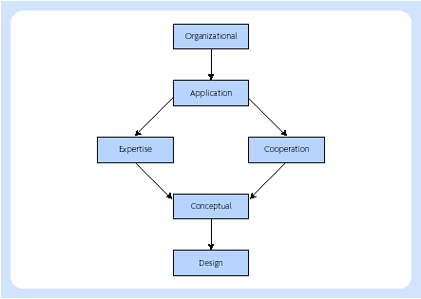
Models and processes of KADS
Organizational model
Application model
Task model
Model of co-operation
Model of expertise
<number>
Notes:
<number>

Slide 17
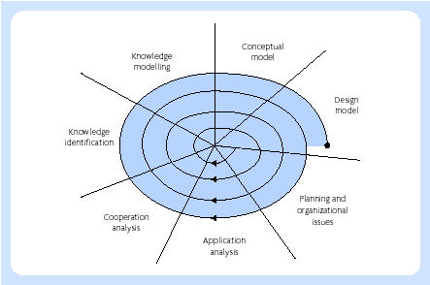
Spiral lifecycle model of KADS
<number>
Notes:
<number>

Slide 18
Categories of Knowledge
Domain knowledge
Inference knowledge
Task knowledge
Strategic knowledge
<number>
Notes:
<number>

Slide 19
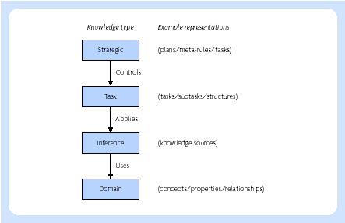
KADS four layer model for modelling expertise
<number>
Notes:
<number>

Slide 20
CommonKADS
CommonKADS is a methodology to support structured knowledge engineering. It has been gradually developed and has been validated by many companies and universities in the context of the European ESPRIT IT Programme. It now is an european de facto standard for knowledge analysis and knowledge-intensive system development, and it has been adopted as a whole or has been partly incorporated in existing methods by many major companies in Europe, as well as in the US and Japan.
<number>
Notes:
<number>

Slide 21
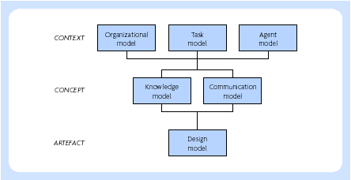
CommonKADS
<number>
Notes:
<number>

Slide 22
CommonKADS
Organization model
supports analysis of an organization,
Goal: discover problems, opportunities and possible impacts of KBS development.
Task model
describes tasks that are performed or will be performed in the organizational environment
Agent model
describes capabilities, norms, preferences and permissions of agents (agent = executor of task).
Knowledge model
gives an implementation-independent description of knowledge involved in a task.
Communication model
models the communicative transactions between agents.
Design model
describes the structure of the system that needs to be constructed.
<number>
Notes:
<number>

Slide 23
CommonKADS
Three main stages in the construction of a knowledge model:
Knowledge identification
Knowledge specification
Knowledge refinement
<number>
Notes:
<number>

Slide 24
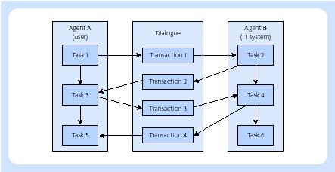
Knowledge transfer in commonKADS
<number>
Notes:
<number>

Slide 25

End of Chapter 24
Thank
You for Your
Attention
<number>
Notes:
<number>

